Slide 1
Responsive design - (Day 1)
Viktoras Lava www.viktoraslava.lt

Slide 2
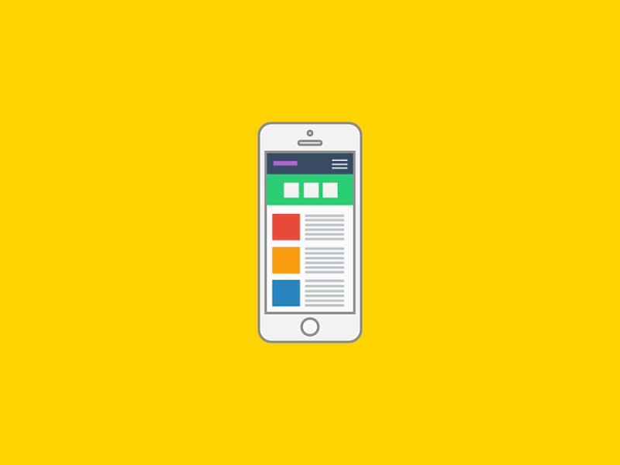
What does responsive design mean ?
Responsive web design is an approach which suggests that design should respond to user’s behaviour and environment based on screen size, platform and orientation.

Slide 3
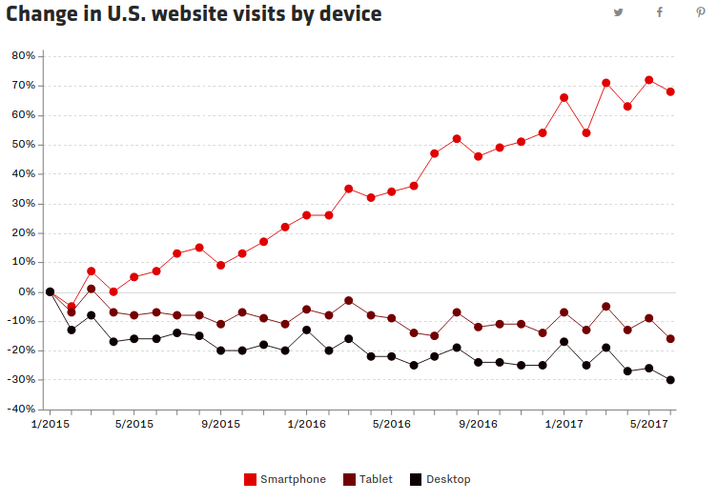
Do you really need a responsive website?
52% percent of global web traffic originated from mobile devices in 2017.
If your business website is not responsive, then your are only “half” visible on the global internet.

Slide 4
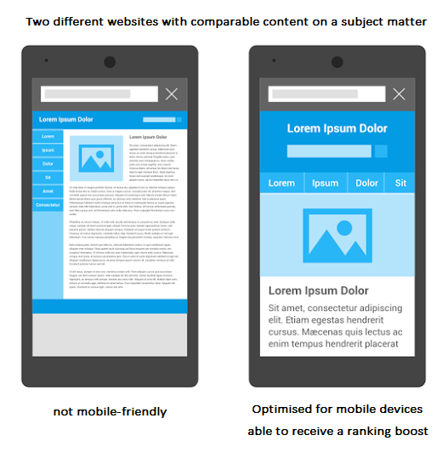
What are other benefits?
If your website is mobile-friendly then you will likely get a ranking boost from search engines like Google.
You can check if your website is mobile-friendly here.

Slide 5
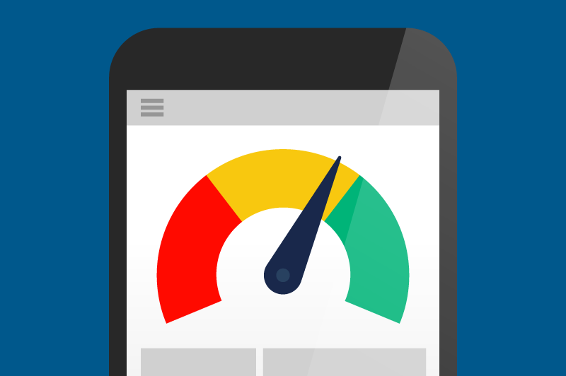
What else is very important?
It is very important to optimize your website very well, because mobile device takes more time to load a website.
You can check how well optimized your website is here:
Google PageSpeed
Pingdom

Slide 6
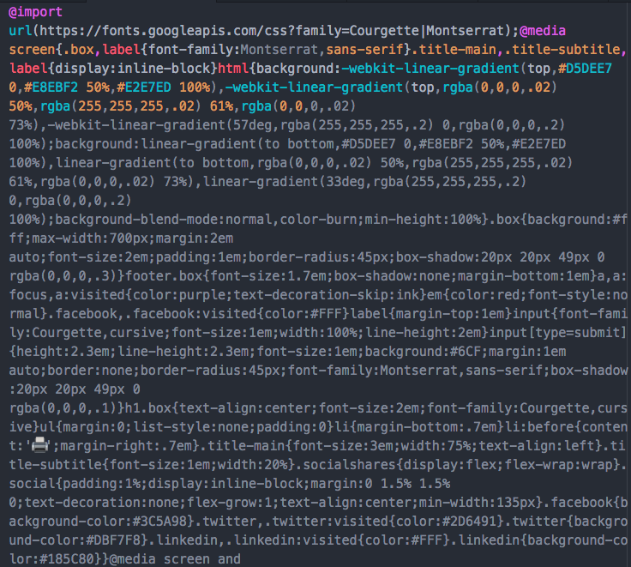
How to keep your website clean?
Minify your CSS and HTML
Minify your Javascript
Optimize images ( try to avoid images that are bigger than 500 kB, crop them if neccessery)
Optimize videos, use .webm or .mp4 format
Remove font variations that you are not using

Slide 7
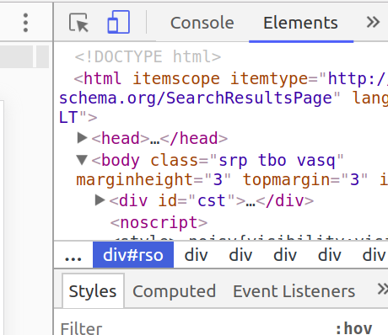
So how to make your website responsive?
The process is very simple:
Add HTML viewport meta tag
Open the device toolbar on Chrome browser
Start writing media queries in CSS to target specific screen sizes

Slide 8
Min-width media query
@media (min-width: 900px) {
body {
background: red;
}
}
The easiest media query would be on the right.
It will make your body element red when the screen size is above 900px.
Example

Slide 9
Max-width media query
@media (max-width: 900px) {
body {
background: red;
}
}
The max-width media query is opposite to min-width.
It will make your body element red when the screen size is below 900px.
Example

Slide 10
Using min-width and max-width together
@media (min-width: 600px) and (max-width: 900px) {
body {
background: red;
}
}
It is possible to use both min-width and max-width together to target screen size ranges.
This will make your body element red when the screen size is between 600px and 900px.
Example

Slide 11
Questions?

